Slide 1

CSE4227 Digital Image Processing
Chapter 8 – Image Fidelity Criteria in Image Compression
Dr. Kazi A Kalpoma
Professor, Department of CSE
& Director of ICT
Ahsanullah University of Science & Technology (AUST)
Contact: kalpoma@aust.com
Google Class code: cgxyzjp
CSE | AUST
Fall 2020

Slide 2
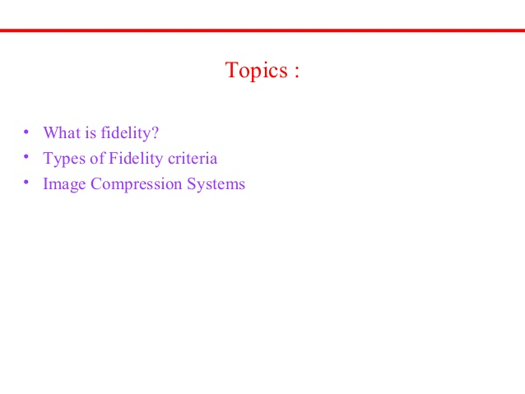

Slide 3

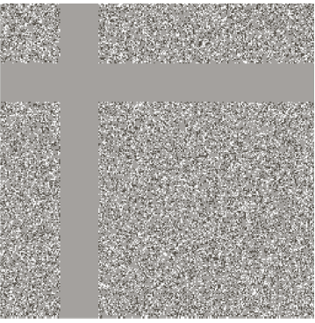
Assessment of loss
removal of irrelevant information removes useful invisible information, too

Slide 4
Assessment of loss
Information is lost in many other compression techniques : Lossy compression
HOW to Assess the loss???

Slide 5
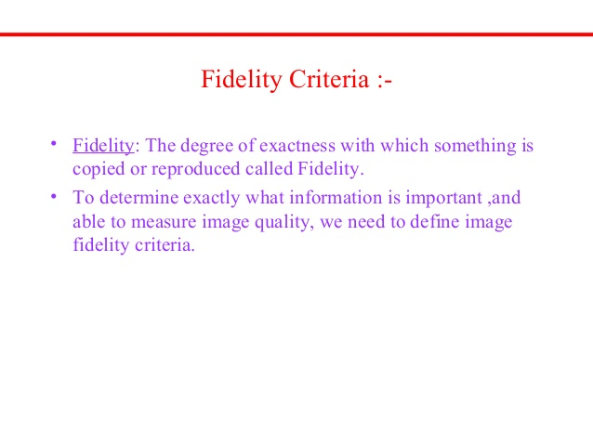
Fidelity criteria can be divided into classes
  Objective Fidelity Criteria
  Subjective Fidelity Criteria

Slide 6
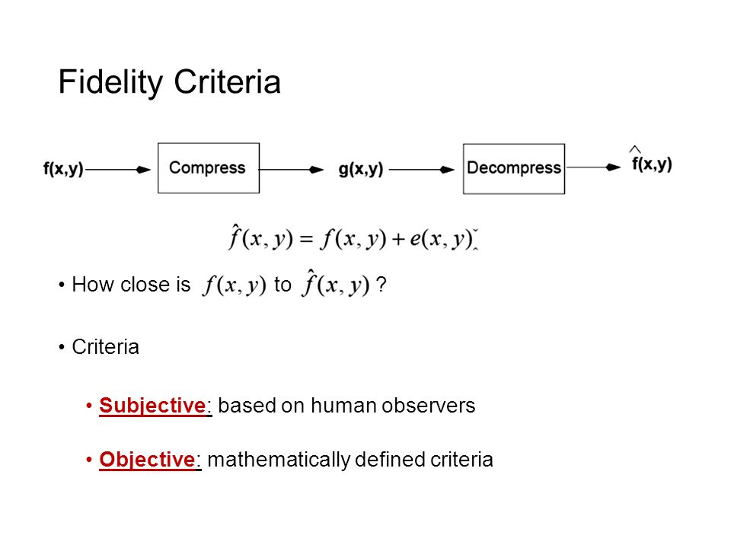
Image Fidelity Criteria
Assessment of loss or infidelity:
Objective fidelity: quantizable
Subjective fidelity: person dependent

Slide 7
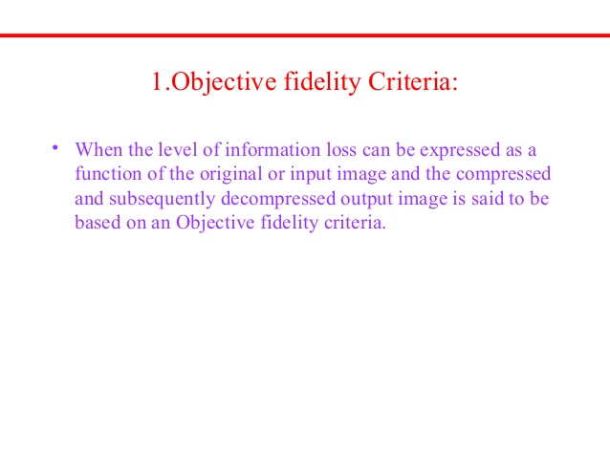

Slide 8
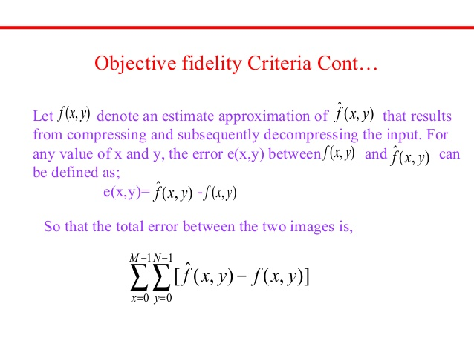

Slide 9
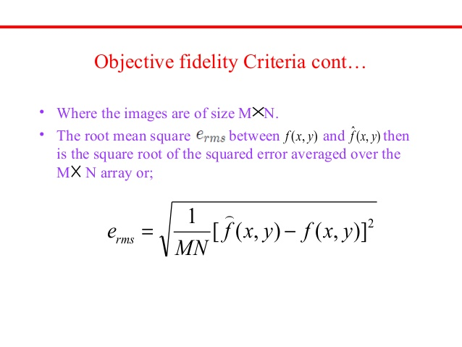
Root Mean Square Error
The smaller the value of root mean square, the better the compressed image represents the original image.

Slide 10
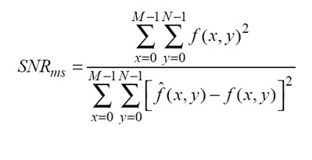
Signal-to-Noise Ratio, SNR_{ms}
Mean-square Signal-to-Noise ratio of the output image:
A large number of SNR implies a better image.

Slide 11
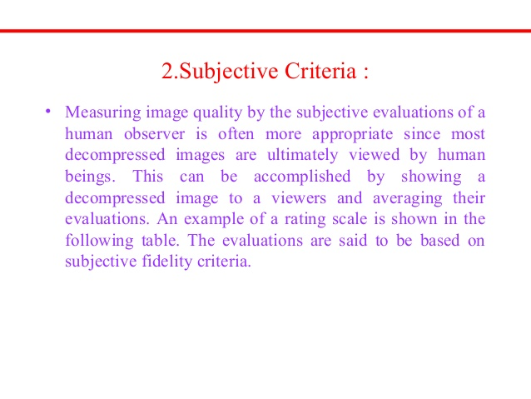

Slide 12
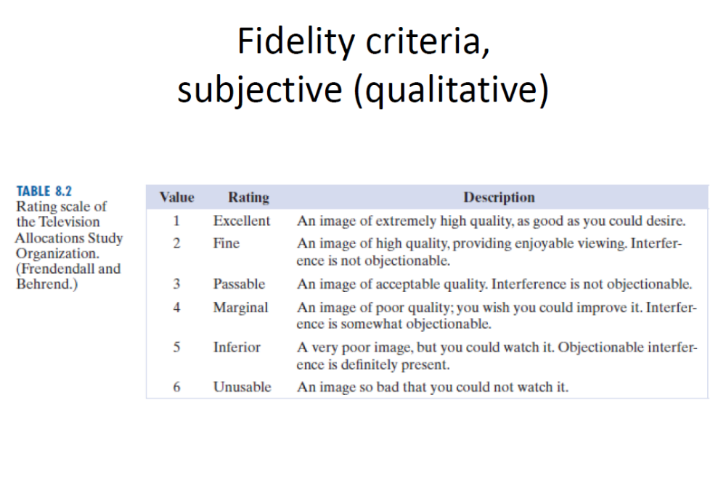

Slide 13
